Slide 1
Customer Retention

Slide 2
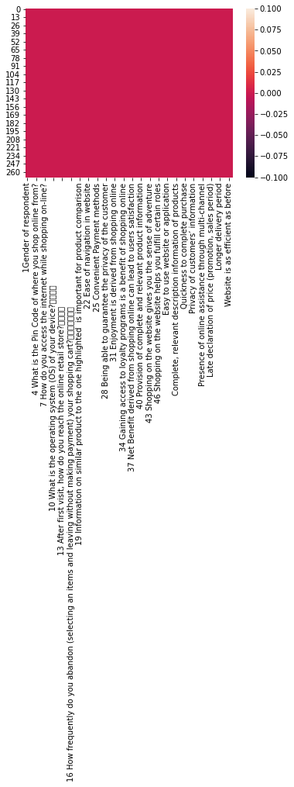
hHeatmap representing Null values

Slide 3
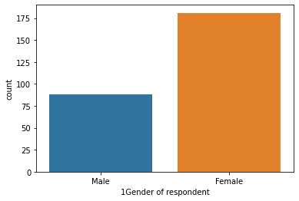
Data visulaization
m
Males-88,Females-181

Slide 4
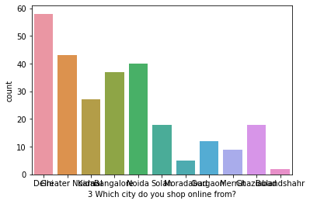
Which city do you shop online from?
from the above observation we can see highest no of people shopping is the highest in Delhi and least in Bulandshahr

Slide 5
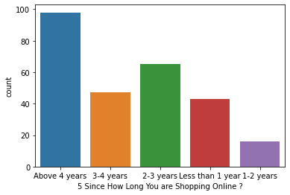
Since How Long You are Shopping Online ?
rom the above observation 98 people are shopping above 4 years and 16 people are shopping in the range of 1-2 years

Slide 6
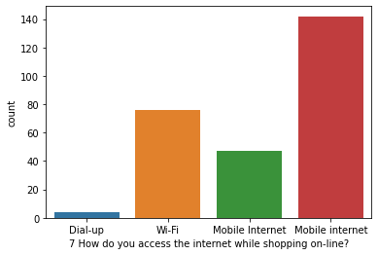
How do you access the internet while shopping on-line?
from the above observation 142+47(189) people use moblie internet for on-line shopping,76 people use wifi and 4 people use dial-up sources for on-line shopping

Slide 7
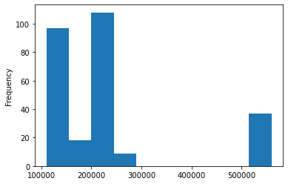
Graphical representation of skewness

Slide 8
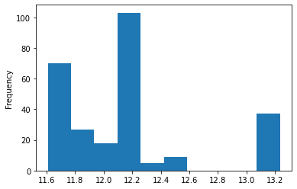
Graph showing the removal of skewness

Slide 9
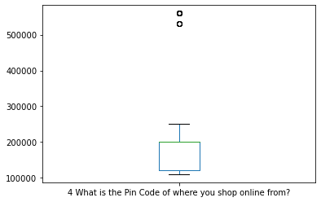
Box-Plot showing the presence of outlier

Slide 10
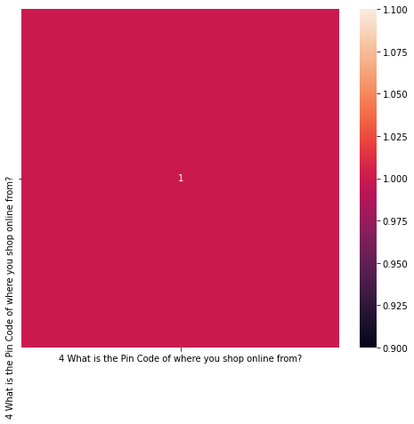
Heat map showing the corelation

